Slide 1
HS 200
SOCIAL ISSUES AND THE ENVIRONMENT
D.Parthasarathy
India Value Fund Chair Professor, Department of Humanities and Social Sciences
Associate Faculty and Convener, Centre for Excellence in Climate Studies
Associate Faculty, Centre for Policy Studies
Indian Institute of Technology Bombay
Email: ben.dp@iitb.ac.in; dp@hss.iitb.ac.in

Slide 2
Environment, Governance, and the state
How do humans interact with ecosystems to maintain long-term sustainable resource yields?
What form of ownership and governance is best for sustainability? For preventing resource degradation or depletion?
Regulation
Ownership

Slide 3
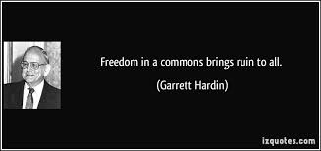
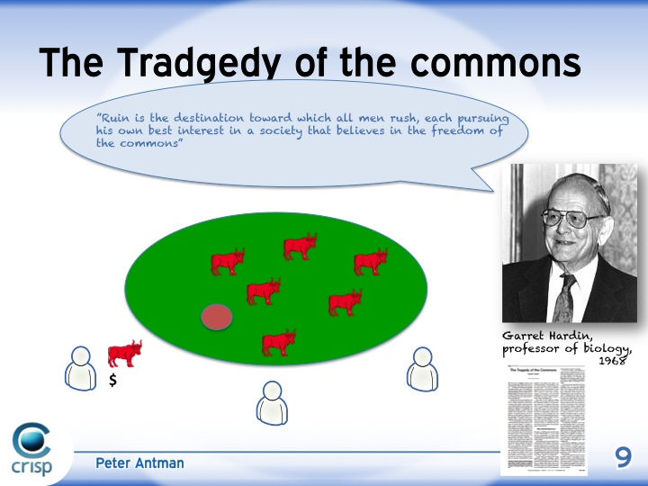

Government, private, or common for efficient resource management?
Common Pool Resources: Water, irrigation systems, Pasture / grazing land, forests, fisheries, oil fields, minerals
Garett Hardin: Tragedy of the Commons?
Open Access, Free rider – overuse and exploitation

Slide 4
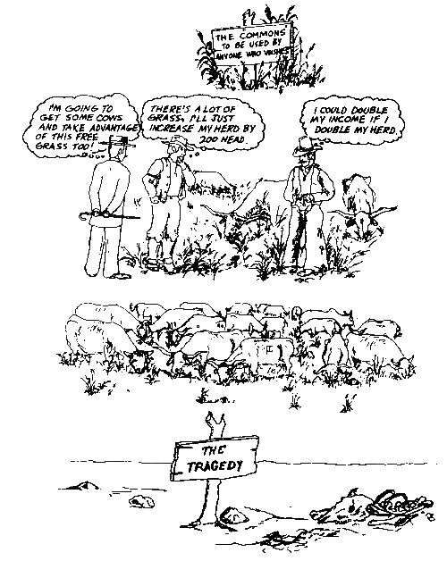
COMMONS: Tragedy or Mutual Benefit?
Understanding the commons: http://www.youtube.com/watch?v=otmrkhEFSZM

Slide 5
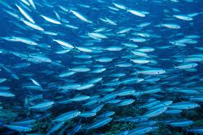

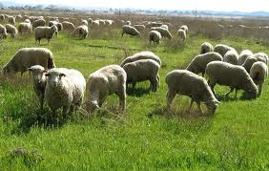
How do humans interact with ecosystems to maintain long-term sustainable resource yields?
Multiplicity of governance and ownership arrangements
Elinor Ostrom: Governance of the Commons
How societies develop diverse institutional arrangements for managing natural resources and avoiding ecosystem collapse and prevent resource exhaustion?
They develop rules, norms, institutions, principles
Elinor Ostrom on managing "common pool" resources: http://www.youtube.com/watch?v=D1xwV2UDPAg

Slide 6
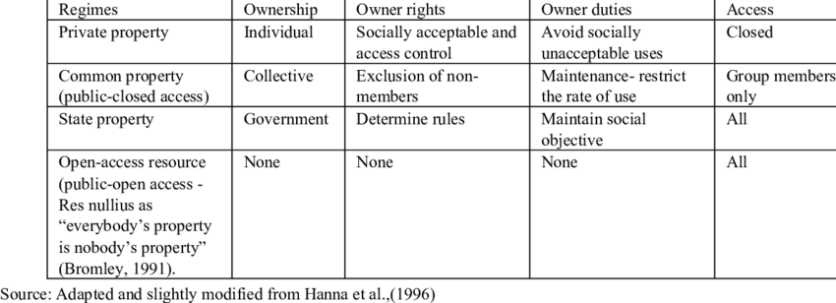

Slide 7
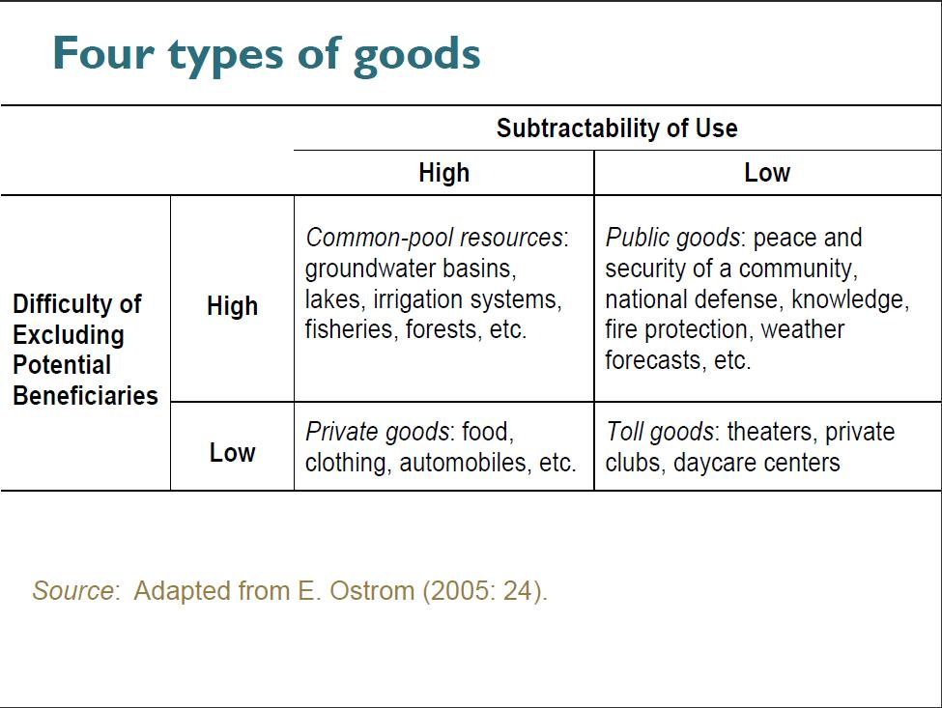

Slide 8

Elinor Ostrom: Governance of the Commons (contd.)
Multifaceted nature of human–ecosystem interaction
Diverse social-ecological system problems
No singular or unique "panacea" for these problems
7 short films on the Commons - by Amar Kanwar and FES, India: http://www.youtube.com/watch?v=1fQn5rBkrSY

Slide 9
“Design Principles" for stable common pool resource management
Improve efficiency, prevent resource exhaustion, and avoid ecosystem collapse
Define boundaries clearly (to exclude external un-entitled parties)
Adapt rules regarding appropriation & provision of common resources to local conditions
Collective-choice arrangements: allow resource appropriators to participate in decision-making process
Effective monitoring (by monitors part of or accountable to appropriators)
Graduated sanctions for resource appropriators who violate community rules
Mechanisms of conflict resolution that are cheap and easy of access
Self-determination of community recognized by higher-level authorities
For larger common-pool resources: organize through multiple layers of nested enterprises - small local CPRs at base level

Slide 10
Common Pool Resources: The multiple advantages of maintaining and restoring the commons:
7 short films on the Commons - by Amar Kanwar and FES, India
https://www.youtube.com/watch?v=1fQn5rBkrSY
Development, Governance and Institutions, Inequality, Access, Resource Commons, Information Commons, Cultural Commons, Intellectual Property Rights, Biodiversity

